Slide 1
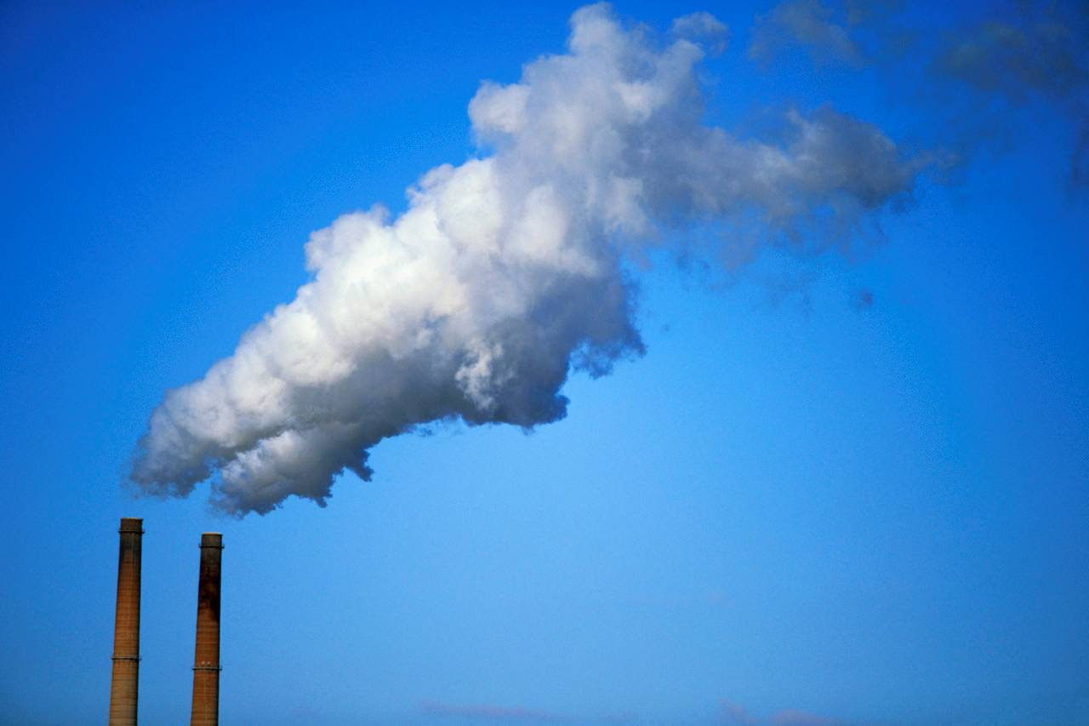
HSPH Capstone Project
Air Pollutant Models
Keyan Halperin
Justin Lee
Chris Hase
Casey Meehan

Slide 2
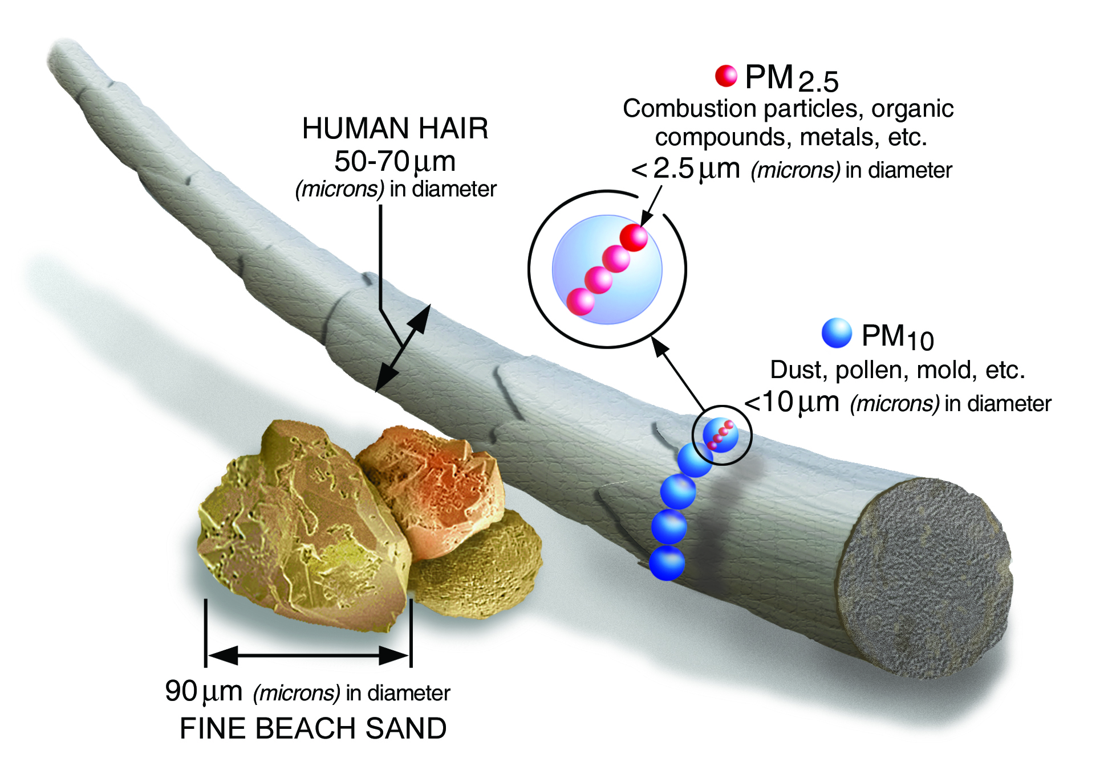
Pollution Smollution...
Lung Cancer
Asthma
Heart Attack
Stroke

Slide 3
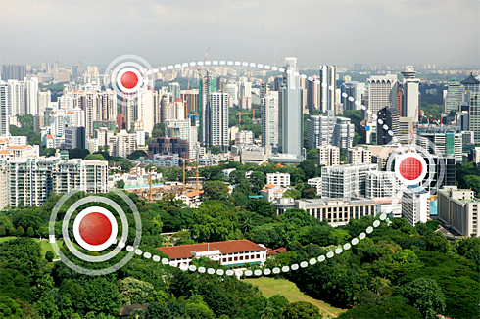
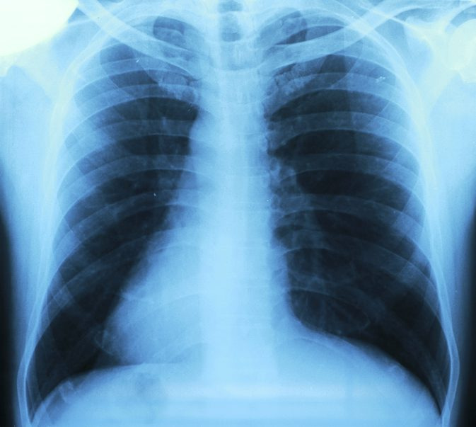

Partner Mission:
What’s hurting us? How? What do we do?
1
2
3

Slide 4
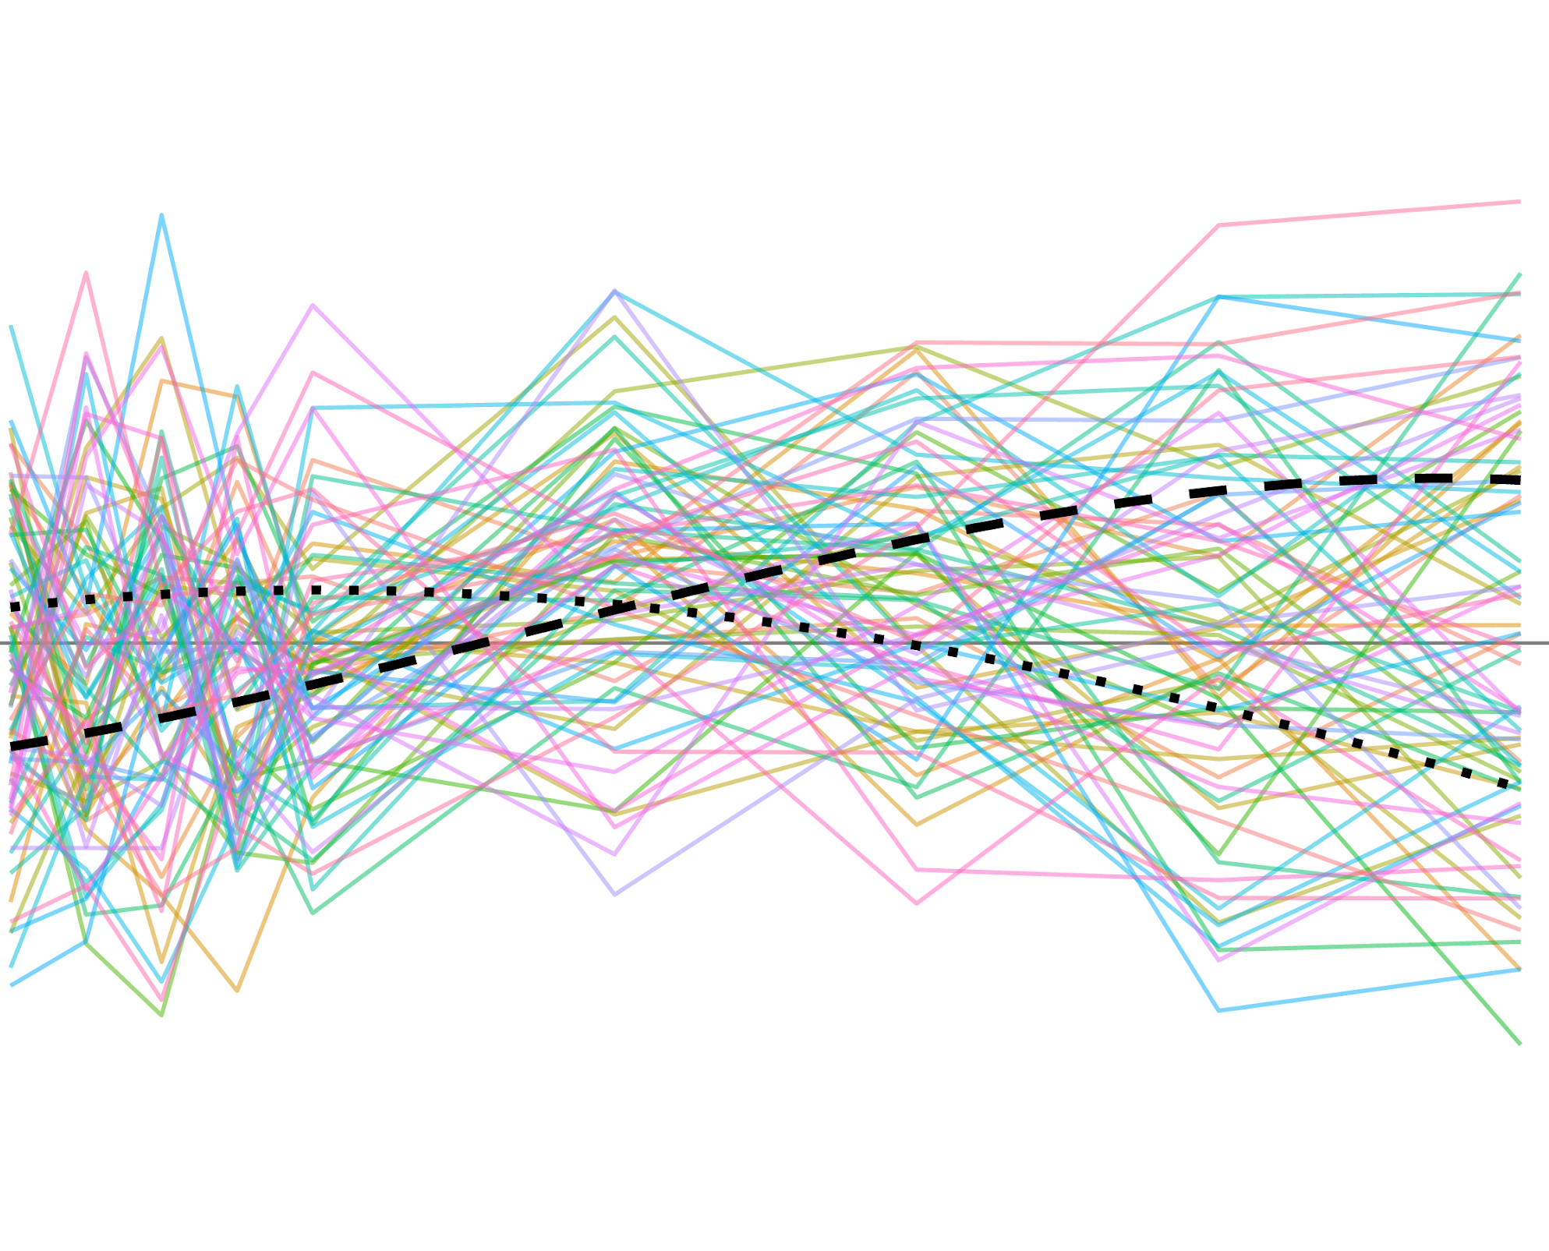
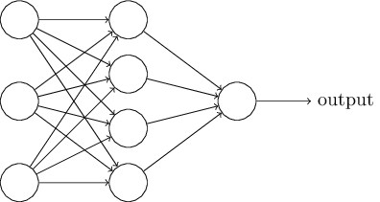

Confidence with Causation
Pollution Prediction
Geographic
Data
Causal Health Outcomes

Slide 5
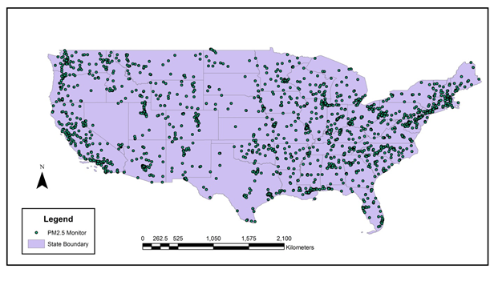
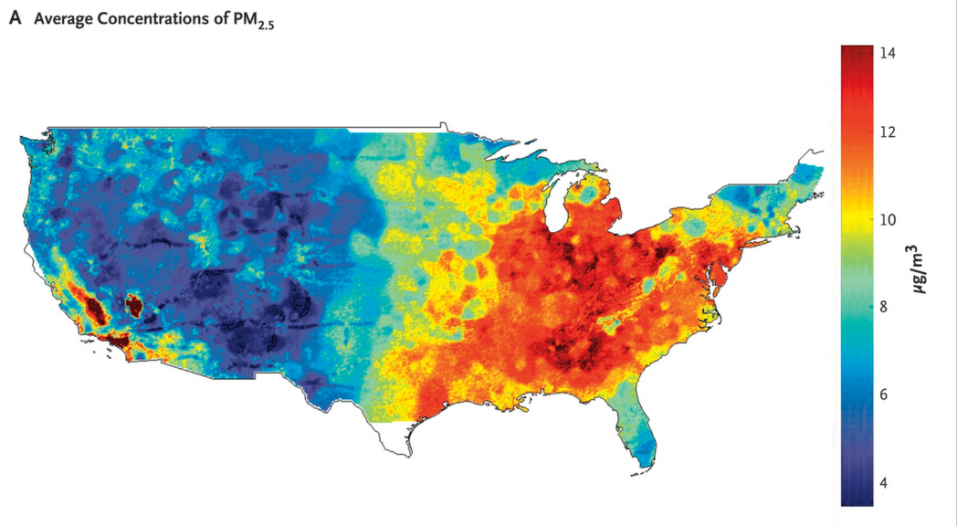
PM_{2.5} Predictions
Sensor Network
Prediction Map
We have PM_{2.5} sensor outputs for locations with monitors
Goal is to produce accurate PM_{2.5} values for the entire US

Slide 6
PM_{2.5} Sensors
Daily PM_{2.5} outputs from 2,156 monitors over the course of 16 years (2000 - 2016)
Sensors tend to be located along the coasts and in more heavily populated areas

Slide 7
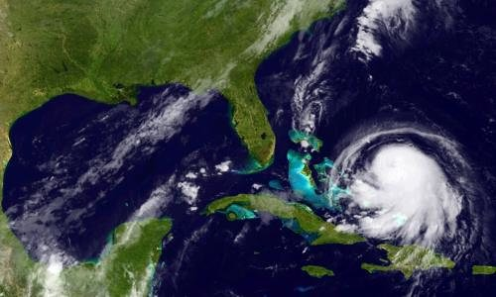
Model Inputs - Geographic Data
Weather, topography, and satellite information for areas across the US
~18 GB
Examples include precipitation rate, air temperature, soil moisture content, and UV index
Significant proportion of missing data - all variables have at least some missing values

Slide 8
Things to consider
The data has spatial and temporal components that we need to consider when determining the structure of our model
RNNs, CNNs?
The areas without sensors may be quite different than the areas with sensors, so need to concern ourselves with degree of extrapolation of PM_{2.5} predictions

Slide 9
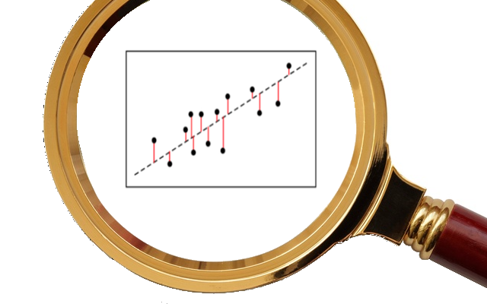
Promising Leads
Properties of locale of interest
Elevation, road density, vegetation, natural features
Satellite measurements of atmospheric properties
Spatial and temporal nearby terms

Slide 10
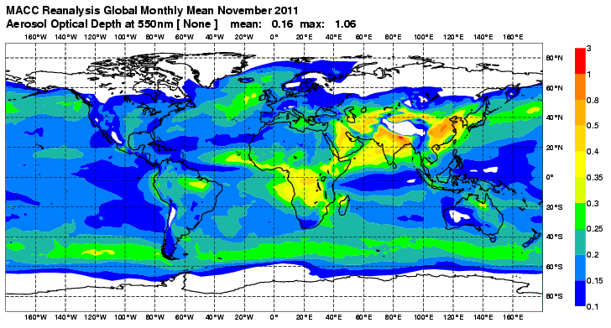
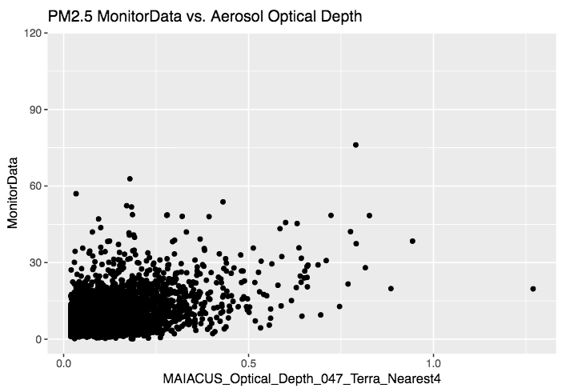
Promising Leads - Aerosol Depth

Slide 12
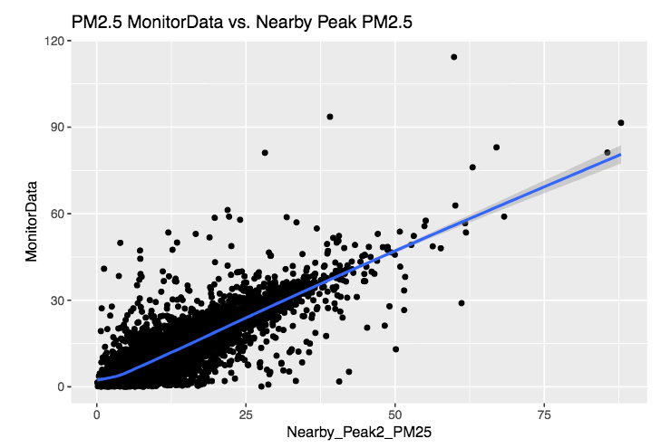
Promising Leads - Nearby Terms

Slide 13
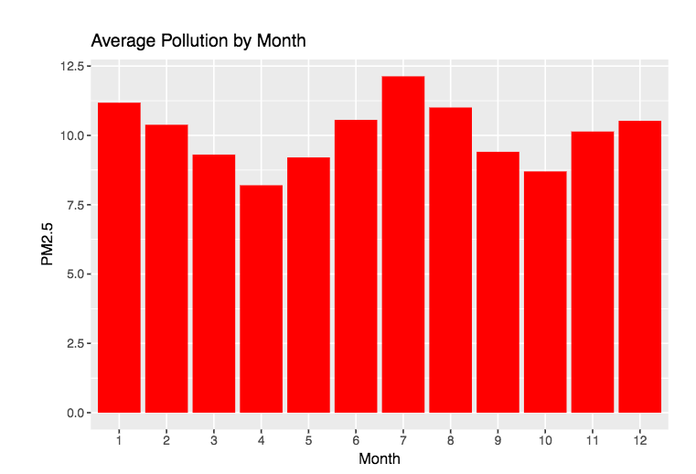
Promising Leads - Seasonal Variations

Slide 14
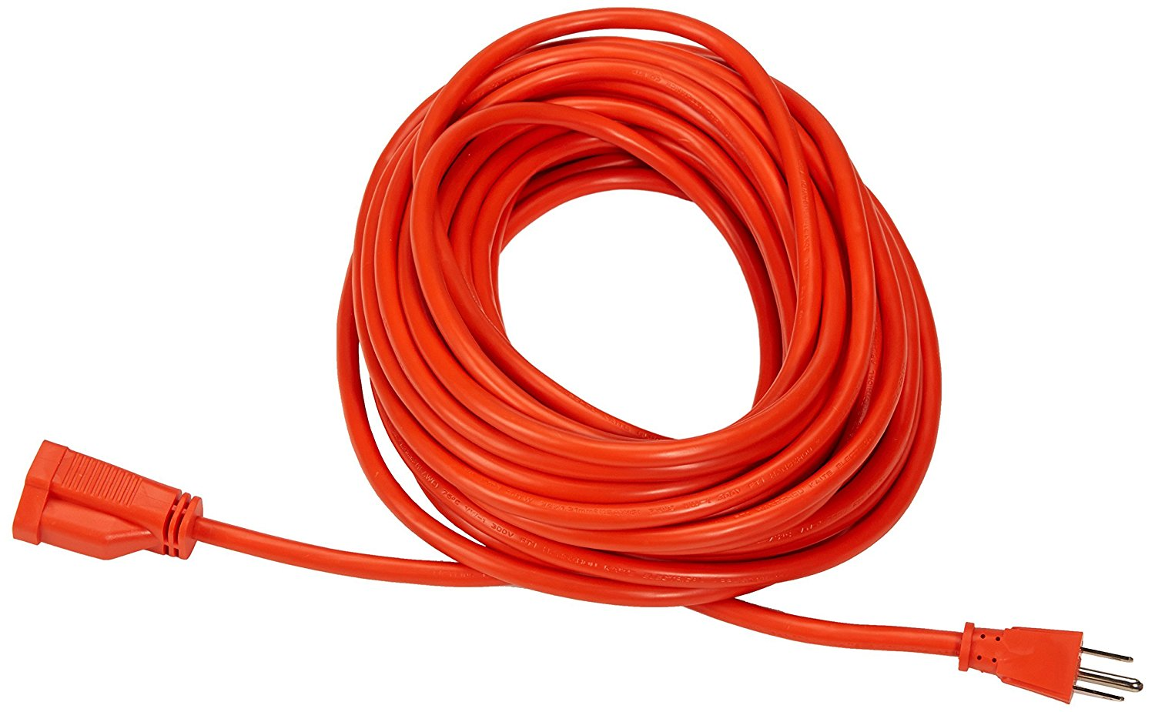
Extensions
Notes:
Although we are primarily interested in significantly improving the pollution prediction model (so that the relationship between pollution and health outcomes can be more accurately explored), time permitting, we would also like to explore a few other extensions of this project.

Slide 15
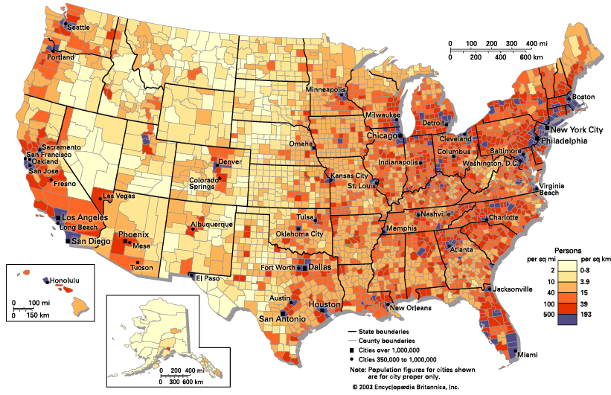
Incorporating External Data
Notes:
One thing we would like to do is incorporate external data like population density and socioeconomic information in order to both (improve our predictions as well as) explore and visualize the precise relationships between these variables and pollution severity.
We believe there are some potentially useful predictors that could significantly improve our predictions. We would also be interested in exploring and visualizing the precise relationship between these variables and pollution severity. Some examples include population density and socioeconomic data.

Slide 16
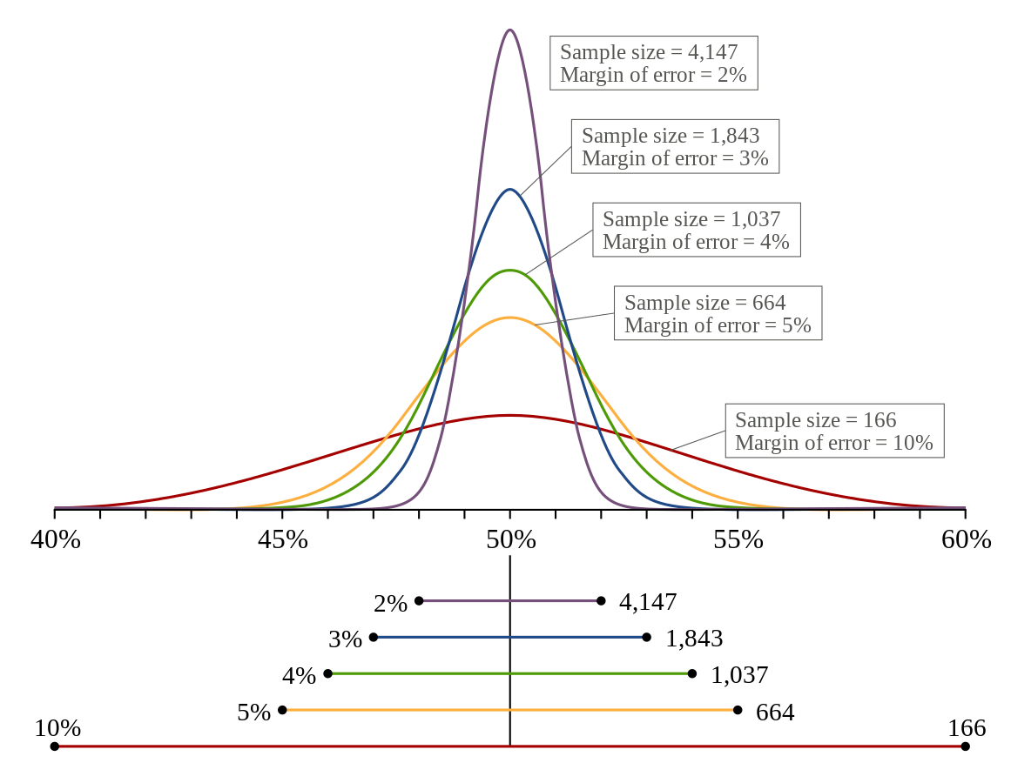
Prediction Margin of Error
Notes:
Also, because we are making pollution predictions in areas where there is no pollution data, there is a lot of uncertainty about the accuracy of the predictions. Thus, in addition to providing point estimates, if possible, we would like to estimate the margin of error for our predictions as well.

Slide 17

Optimal Sensor Locations
Notes:
And most importantly, because the sensors are so sparsely located, there is an apparent need for new sensors to be installed. As a result, it would be incredibly useful to prioritize new sensor locations based on factors like (proximity to closest sensor), population density, and pollution uncertainty.

